Slide 1
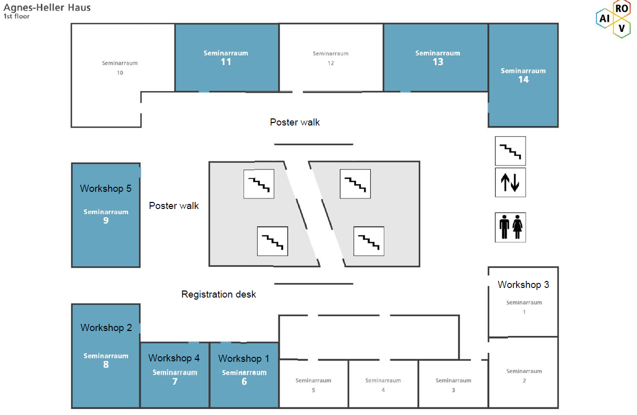
Workshop 1. Drug-related problem classification
Workshop 2. Interventions to enhance medication adherence in community pharmacy – how to develop efficient strategies with self-report questionnaires such as the 15-STARS
Workshop 3. From guidelines to quality indicators: pharmaceutical care for diabetes type 2 in a global context
Workshop 4. Enhancing pharmaceutical care: exploring and coding pharmacist-patient communication
Workshop 5. How to meet the patient needs? Employing design thinking into pharmaceutical care innovation projects
Ground floor/entrance

